Slide 1
DECOUPLED VECTOR RUNAHEAD
SHENGMIN LIU

Slide 2
TABLE OF CONTENT
Background and Motivation
DVR Microarchitecture
  Discovery mode
  VR Subthreads
  Nested Vector Runahead
Performance Evaluation

Slide 3
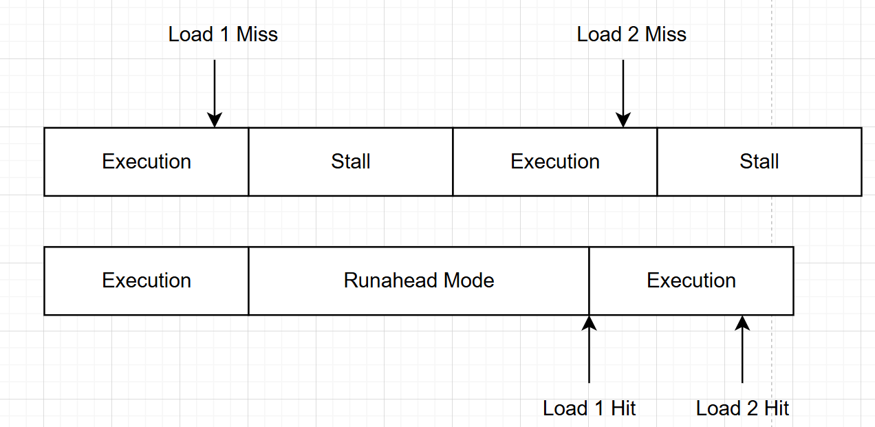
BACKGROUND
Runahead
Vector Runahead
  Indirect Memory Access
  Vectorize Instruction

Slide 4
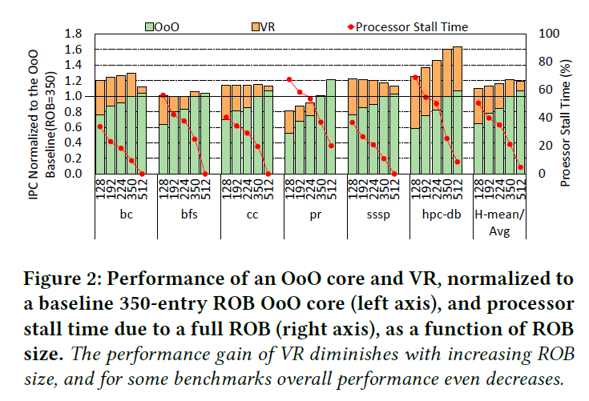
Notes:
1.
2.This delayed termination stalls the commit stage on average 7.1% (and up to 11.8%) of the total execution time in VR across our set of benchmarks
Figure 2: Performance of an OoO core and VR, normalized to
a baseline 350-entry ROB OoO core (left axis), and processor
stall time due to a full ROB (right axis), as a function of ROB
size. The performance gain of VR diminishes with increasing ROB
size, and for some benchmarks overall performance even decreases.

Slide 5
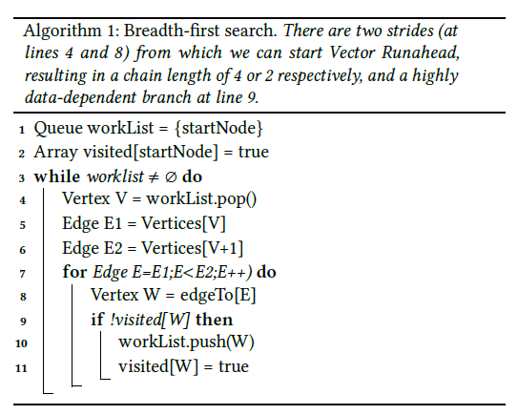

Slide 6
LIMITATIONS OF VR
Performance Boost Diminish with Bigger ROBs
Delayed Termination Stalls Commit
No adaption to run-time characteristics
Inability to Vectorize Multiple Invocations of the Same Loop
Inability to Handle Control-Flow Divergence

Slide 7
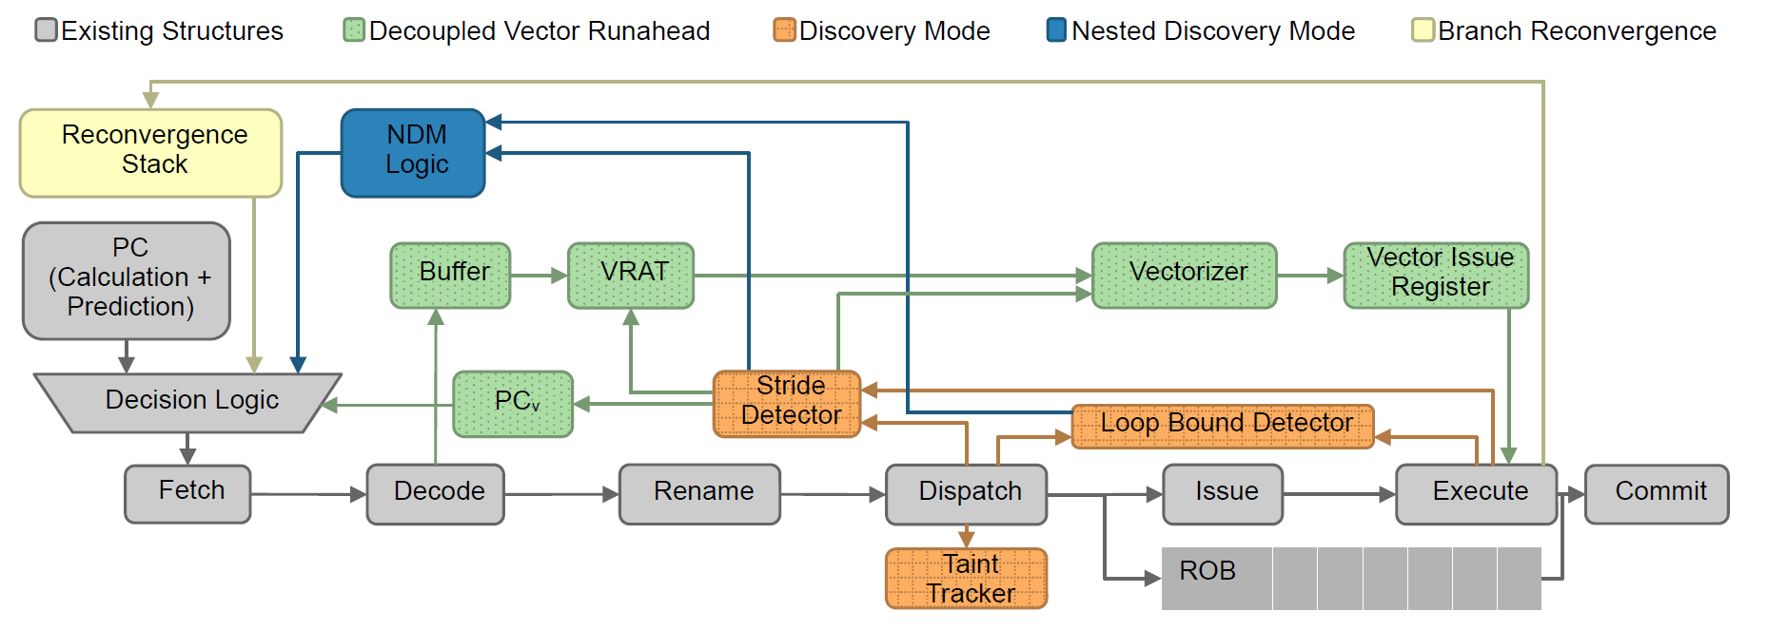
DVR MICROARCHITECTURE
Notes:
Figure 3: DVR processor pipeline. The stride detector obtains information about loads from the dispatch and execute stages of the pipeline.
Once a stride is detected, DVR enters Discovery Mode, which uses the Taint Tracker and Loop-Bound Detector to discover information for the
subsequent runahead. The Nested Discovery Mode logic will be used if Discovery Mode finds too few elements of the loop to vectorize. Once
Discovery Mode is complete, the vector program counter (𝑃𝐶𝑣 ) will be populated with the PC of the striding load, the VRAT will be populated
with the striding load addresses and a copy of the main thread’s scalar registers, and the decoupled vector-runahead subthread will initiate. The
Reconvergence Stack will engage upon divergence in control-flow between the vector lanes.

Slide 8
DISCOVERY MODE
Innermost Striding-Load Detection
  Reference Prediction Table
  Keeps track of all striding loads and a 1-bit value per entry to find out the inner stride.

Slide 9
DISCOVERY MODE
Dependent-Load Checking
  Vector Taint Tracker
    A single bit per architectural integer register
  Final Load register
    A register that holds a single load PC
  To make sure the triggered DVR is meaningful

Slide 10
DISCOVERY MODE
Loop-Bound Inference
  Last-Compare Register
    stores compare source
    stores destination architectural register IDs
  Seen-Branch Bit
    set when branch locate
    does not change unless a new final load
  Two checkpoints of register file to determine loop iterations
Notes:
(i) the constant value as the loop bound, and
(ii) the difference in the changing value as the loop increment.
If we
see a branch whose source matches the LCR destination and whose
branch-taken destination is less than or equal to the striding load’s
PC,1 then we set the SBB, to indicate that we should not alter the
LCR unless we see a new final load.

Slide 11
LIMITATIONS OF VR
Performance Boost Diminish with Bigger ROBs
Delayed Termination Stalls Commit
No adaption to run-time characteristics
Inability to Vectorize Multiple Invocations of the Same Loop
Inability to Handle Control-Flow Divergence

Slide 12
VR Subthread
-Striding Load, Stride, Dependence Chain, Remaining Iterations Ready
-Spawn Vector Runahead Subthread
-Use same units as main thread when they are not occupied

Slide 13
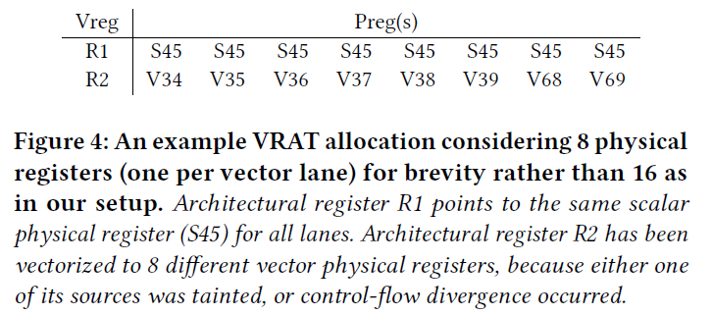
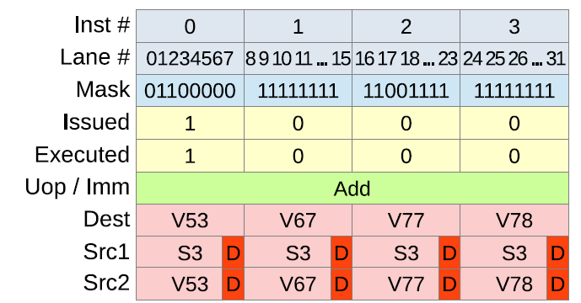
VR SUBTHREAD
Vector Register Allocation Table
  same physical register
  multiple vector physical register
Vector Issue Table
  A buffer for issuing instructions(In Order).
  Issued to suitable unit when it is free
Notes:
(i) the same scalar physical register in all vector lanes, in the case where the architectural register is not vectorized and there is no control-flow divergence across lanes,
or (ii) multiple vector physical registers, where the architectural register has been vectorized or there is control-flow divergence.

Slide 14
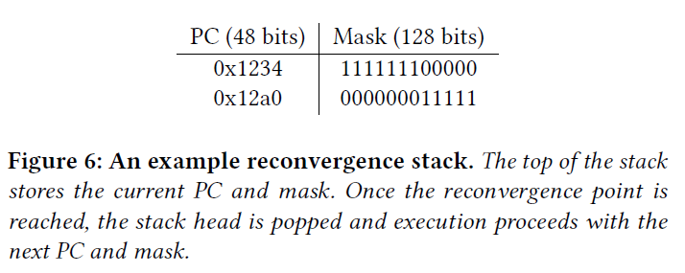
VR SUBTHREAD
Branch Convergence
  Store target PCs and mask
  Go through all possible targets, one by one
Notes:
If the next PC for any lane diverges from the others, we split the lanes based on their new destination, generate masks based on common groups, and place the masks and target PCs onto
a reconvergence stack (Figure 6).

Slide 15
VR SUBTHREAD
Termination
  FLR reached
  Next iteration of Stride PC
  Timeout
Eligible for entering Discovery mode after termination

Slide 16
LIMITATIONS OF VR
Performance Boost Diminish with Bigger ROBs
Delayed Termination Stalls Commit
No adaption to run-time characteristics
Inability to Vectorize Multiple Invocations of the Same Loop
Inability to Handle Control-Flow Divergence

Slide 17
NESTED VECTOR RUNAHEAD
Nested Discovery Mode
  When not enough iterations, begin NDM in subthread
    Look for multiple invocations of inner loops
    Enable more useful prefetch
  Increment Register and Inner Load Register
    Allow DVR to execute correctly
Notes:
find the
starting striding addresses and loop bounds for many different invocations
of the inner loop at the same time.

Slide 18
NESTED VECTOR RUNAHEAD
Further Vectorization
  Based on the multiple loops NDM identified
  Takes up to 128 entries
  DVR
Notes:
The NDM subthread then performs vectorization
from the inner striding load, by populating its vector registers with
these 128 targets, with all other registers set based on which of
the 16 outer-loop lanes it was spawned from (scalar for currently
untainted registers, and vector for registers tainted in NDM).

Slide 19
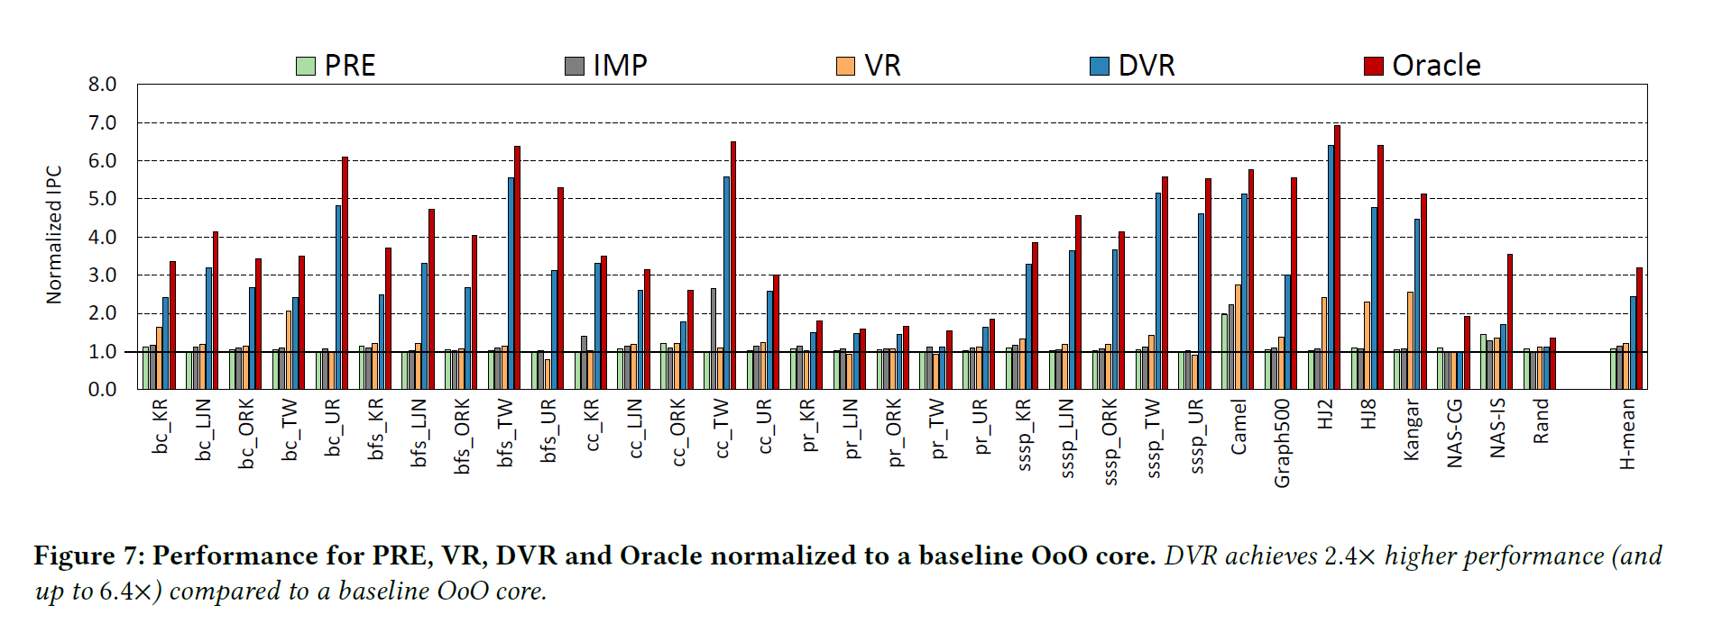
PERFORMANCE EVALUATION
Notes:
DVR achieves 2.4× higher performance (and
up to 6.4×) compared to a baseline OoO core.

Slide 20
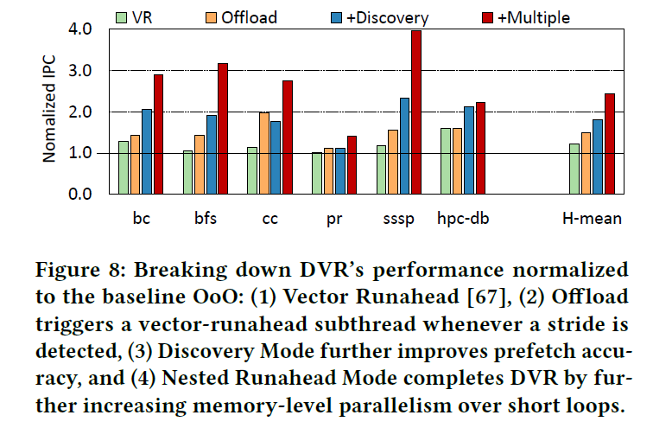
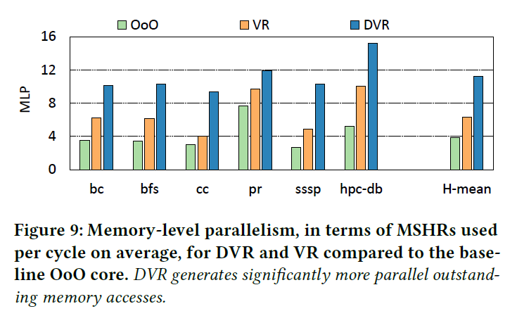

Slide 21
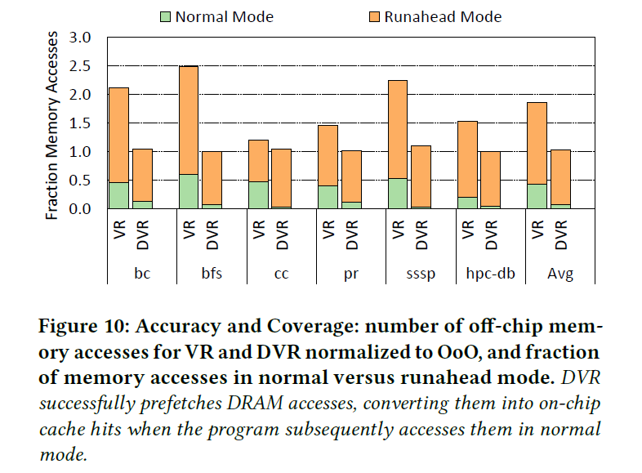
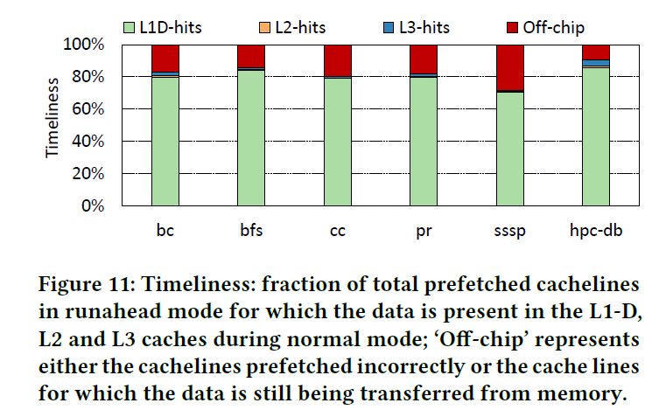

Slide 22
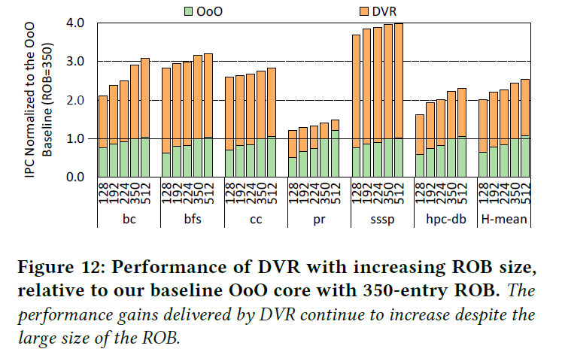

Slide 23
Discussion:HARDWARE OVERHEAD
1139 Bytes according to Paper
Vector Runahead from previous presentation: 1.31KB, PRE 1.24KB
Bits count removes process node variations

Slide 24
Discussion: Workloads
Benchmarks used for simulation are mainly memory-intensive workloads.
Performance on other workloads?

Slide 25
Discussion: Energy/Power
Power consumption differences among PRE, VR, DVR
Increased Power consumption and Impact Energy efficiency
PRE: performance improvement ~18 percent with ~6 percent reduction in energy
On In-order Cores
VR/DVR: impractical for power efficiency
SVR: more hardware overhead but halving the energy.
Notes:
y rely on expensive wide vector execution units, hundreds of pre-existing physical vector registers, and a dedicated execution context (for DVR), which are infeasibly large.

